Slide 1
UNHEARD VOICES
UNHEARD VOICES
- Shagun Talwar
Visualizing Trends, Hotspots, and Vulnerabilities using Power BI
A DATA-DRIVEN ANALYSIS OF CRIMES AGAINST WOMEN IN INDIA (2016-2022)

Slide 2
The dashboard provides a multi-level view of crimes against women in India, moving from a national picture down to state and district micro hot-spots. It consolidates several categories of offences—including rapes, domestic violence, kidnapping, cyber crimes, acid attacks, dowry deaths, human trafficking and miscarriage related deaths—to highlight where and how intensely women are impacted across the country.
OVERALL
PURPOSE
1.
2.
3.
NATIONAL OVERVIEW
STATE-LEVEL LANDSCAPE
DISTRICT-LEVEL HOTSPOTS
high-level counts, time trends and distributions across age and crime types.
identification of high-burden states, severity indices and state-wise patterns.
micro analysis of districts, comparing crime index, total crimes and specific offence categories.

Slide 3

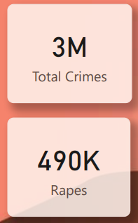
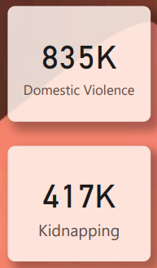
OVERALL CRIME LEVELS ARE HIGH AND RISING.
NATIONAL TRENDS
The “Total Crimes vs Rapes – National Trend” area-plusline chart shows both total crimes and rapes increasing from 2016 to 2022, indicating a growing volume of reported offences over time
YEAR-ON-YEAR (YOY) CHANGE IN CRIMES FLUCTUATES.
The “YoY Change in Total Crimes (%)” line chart shows positive growth in most years with one visible dip, followed by a sharp rise before stabilising again, suggesting that some years experienced spikes or temporary slowdowns rather than smooth growth.
CYBER CRIMES AGAINST WOMEN ARE ON AN UPWARD TRAJECTORY.
The “Cyber Crimes Trend Over the Years” visual on page 1 shows a clear increasing pattern from 2016 to 2022 within a 0–500 scale.
ASSAULTS, DOMESTIC VIOLENCE AND KIDNAPPING REMAIN PROMINENT.
Clustered bars for these three categories grow over time, highlighting continued vulnerability in both public and private spaces.
AGE-BASED VULNERABILITY IS EVENLY DISTRIBUTED.
The donut chart “Age-Based Vulnerability of Women” shows six equal segments, each representing 6.14K cases (16.67%).

Slide 4
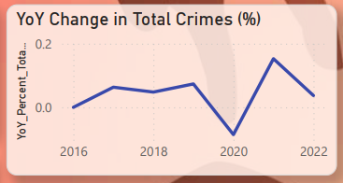
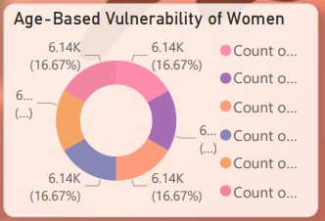
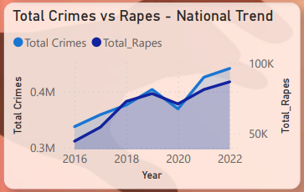
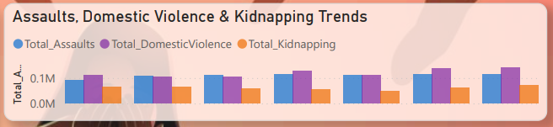
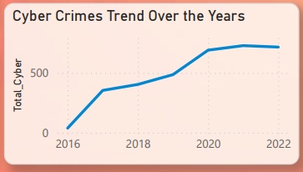
NATIONAL TRENDS

Slide 5
HIGH-VOLUME AND HIGH-SEVERITY STATES
TOP 5 INSIGHTS
States such as Uttar Pradesh, Maharashtra, Rajasthan, West Bengal and Madhya Pradesh consistently appear as top contributors to total crimes and crime severity indices
DOMESTIC VIOLENCE AS A CORE DRIVER
Domestic violence constitutes the largest single share of crimes against women, with 835K cases, accounting for around 30.77% of major crimes shown in the distribution pie chart
DOWRY DEATHS AND HUMAN TRAFFICKING REMAIN SIGNIFICANT IN SPECIFIC STATES
Bihar, Jharkhand, Karnataka, Andhra Pradesh and Assam have notable dowry deaths; some states (e.g., Assam, Haryana, Tamil Nadu, Maharashtra) appear prominently in human trafficking distributions
CONCENTRATION OF DISTRICT-LEVEL HOTSPOTS
Districts like Mumbai, North 24 Paraganas and Hyderabad are highlighted as top districts by total crimes and crime categories (page 3), indicating urban hotspots that require targeted interventions.
EMERGING CYBER-RELATED RISKS
Scatter plots relating cyber crimes to abetment of suicide at both state and district level (pages 2 and 3) hint at a correlation between online harassment/abuse and extreme mental health outcomes.

Slide 6
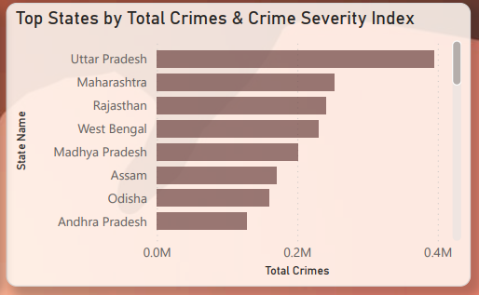
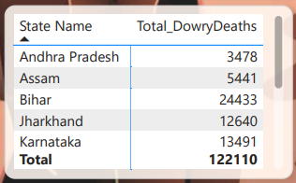
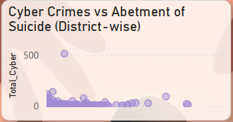
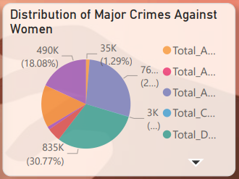
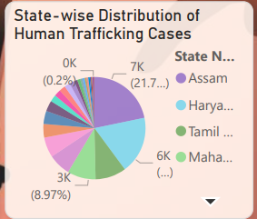
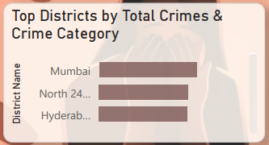
TOP 5 INSIGHTS

Slide 7
MAIN VISUAL TYPES
• KPI cards (3M Total Crimes, 490K Rapes, 835K Domestic Violence, 417K Kidnapping).
• Line and area charts (national trends, YoY change, cyber crimes, state-wise and district-wise rape trends).
• Clustered column charts (assaults vs domestic violence vs kidnapping; kidnapping vs assaults by state and district).
• Donut / pie charts (distribution of major crimes; age-based vulnerability; human trafficking distributions).
• Bar charts (crime severity indices, total crimes, miscarriage-related deaths).
• Tree-map (state-wise distribution of domestic violence).
• Scatter plots (cyber crimes vs abetment of suicide at state and district level).
• Maps (crimes against women across states; acid attacks by state and district).
• Tables (state-wise dowry deaths; district-wise domestic violence totals; district ranks).

Slide 8
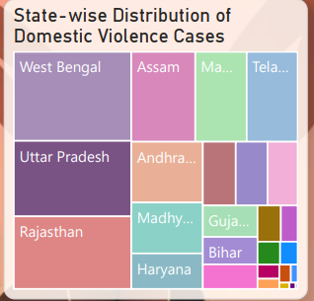
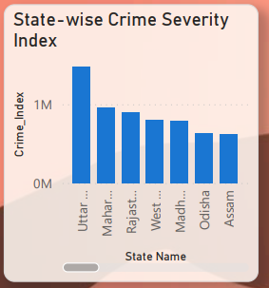
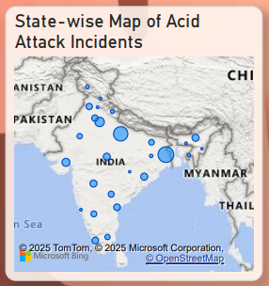
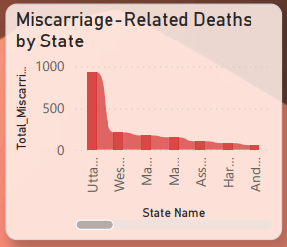
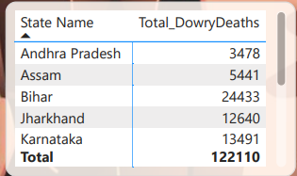
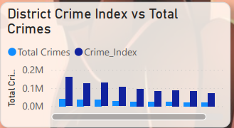
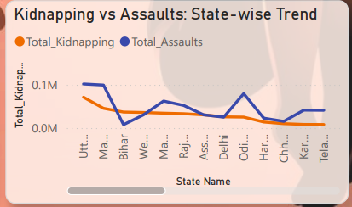
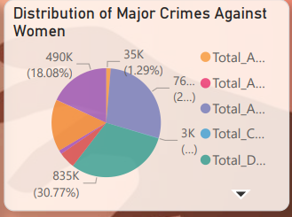
MAIN VISUAL TYPES

Slide 9
PAGE 1: NATIONAL OVERVIEW – “UNHEARD VOICES
• India registers 3M crimes against women in the dataset, with domestic violence (835K) and rapes (490K) as major components.
• Trends for total crimes, rapes, cyber crimes, assaults and kidnapping all increase over time, showing sustained or worsening risk.
• Year-on-year change is mostly positive but volatile, indicating sporadic spikes.
• Age-based analysis reveals uniform vulnerability, demanding life-course oriented safety and justice frameworks.
• Slicers for state, year and district enable analysts to drill into specific geographies for further investigation.

Slide 10
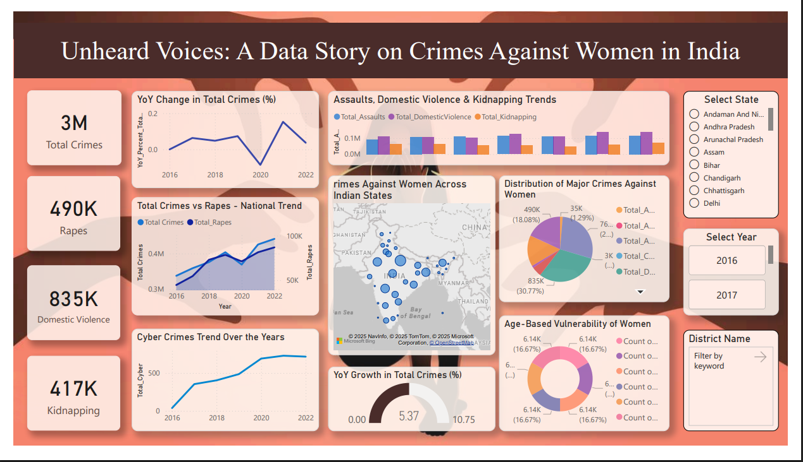

Slide 11

PAGE 2: STATE-LEVEL CRIME LANDSCAPE
• Uttar Pradesh, Maharashtra, Rajasthan, West Bengal and Madhya Pradesh consistently appear as high-burden states across total crimes, crime indices and rape distributions.
• Domestic violence is heavily concentrated in a group of states led by West Bengal and Uttar Pradesh.
• Dowry deaths are particularly acute in Bihar, Jharkhand and Karnataka among others, with 122,110 cases shown for the visible states.
• The human trafficking and miscarriage-related deaths visuals highlight additional dimensions of vulnerability beyond headline crime categories.
• Cyber crimes show a possible positive association with abetment-of-suicide cases, warranting deeper forensic analysis and mental health-oriented interventions.

Slide 12
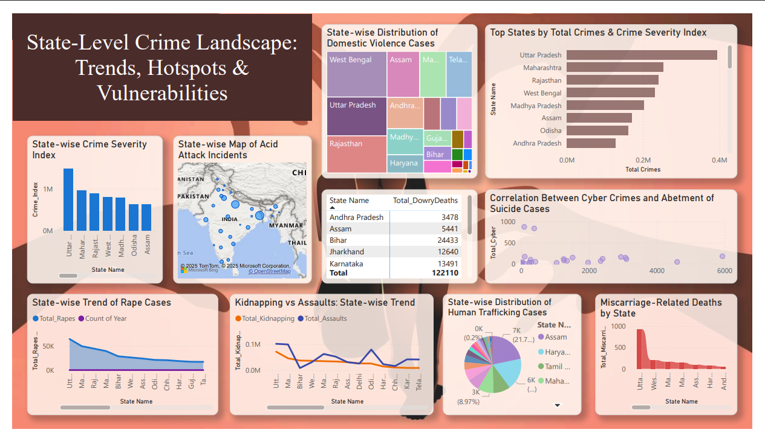

Slide 13
PAGE 3: DISTRICT-LEVEL CRIME HOTSPOTS –
• Major cities and densely populated districts such as Mumbai, North 24 Paraganas and Hyderabad are leading hotspots in total crimes and multiple categories.
• Some districts have disproportionately high kidnapping or assault rates, underscoring the need for district-specific policing strategies.
• Human trafficking and miscarriage-related deaths are far from uniform, with a handful of districts showing extreme values.
• Cyber crime patterns at district level mirror those at state level, reinforcing concerns about digital violence translating into severe psychological outcomes.
• Acid attack maps pinpoint micro-geographies where extremely violent offences occur, enabling ultratargeted interventions.

Slide 14
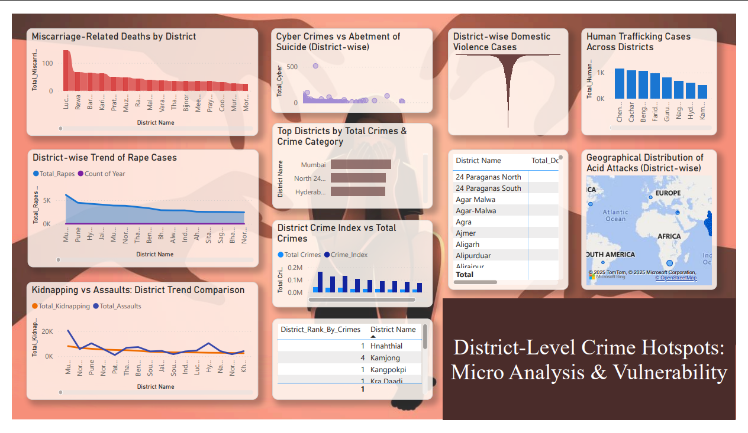

Slide 15
CONCLUSION
Crimes against women in India remain high and are rising every year, showing that women’s safety is still a major concern. Violence is widespread across states, age groups, and even digital spaces, highlighting deep-rooted social and systemic issues.
WHAT NEEDS TO BE DONE ?
  Stronger law enforcement and faster case disposal.
  Awareness & education on gender equality at community and school levels.
  Better reporting systems and support for survivors (helplines, counseling, shelters).
  Digital safety measures to control rising cybercrimes.
  State-level targeted policies for high-burden regions.
  Regular monitoring & data-driven interventions using dashboards like this.

Slide 16
"यत्र नार्यस्तु पूज्यन्ते रमन्ते तत्र देवताः।"
WHERE WOMEN ARE RESPECTED, THE DIVINE RESIDES.

